Slide 1
SAP HANA 2.0 Backup

Slide 2
Backups

Slide 3
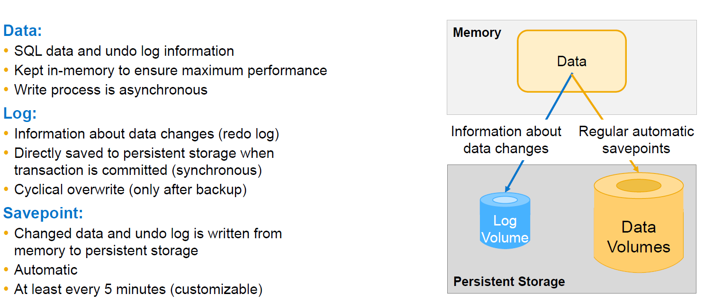
Persistence

Slide 4
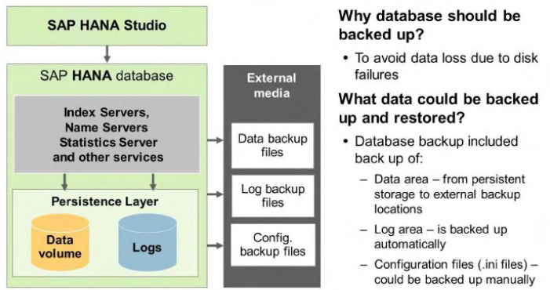
Overview
Backups are performed while the database is running. The impact of backups on system performance is negligible. and users can continue to work normally while the backup is
running.
The properties of an SAP HANA system are defined in the parameters of its configuration files. These files are not backed up as part of the database backup. If you want to back up
configuration files that contain customer-specific changes. you can do so manually.
In a recovery situation. this can be helpful to more easily identify and restore the specific changes. The configuration files are not essential to perform a recovery. If you want to use a specific configuration. you need to reconfigure the recovered system using the SAP HANA studio.
in Linux.

Slide 5
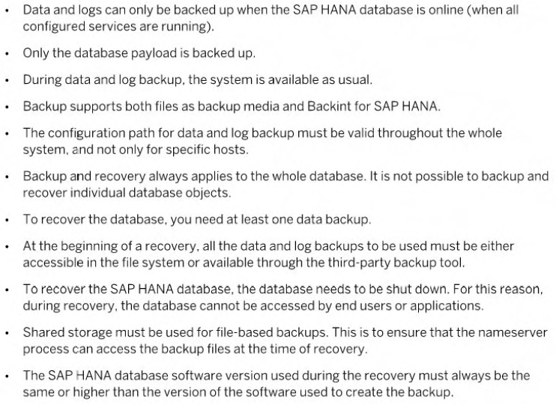
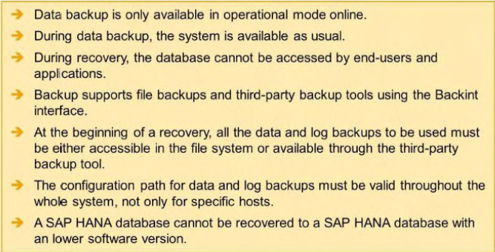
Points

Slide 6
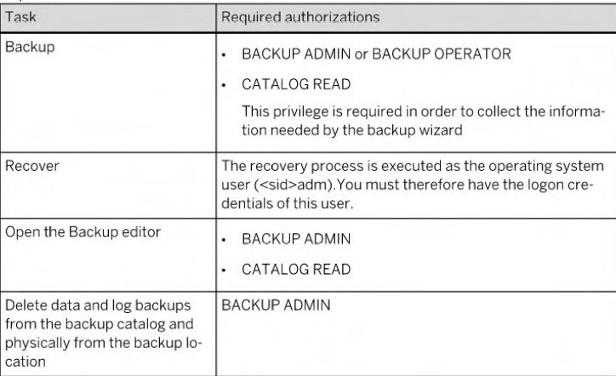
Privileges for Backup and Recovery

Slide 7
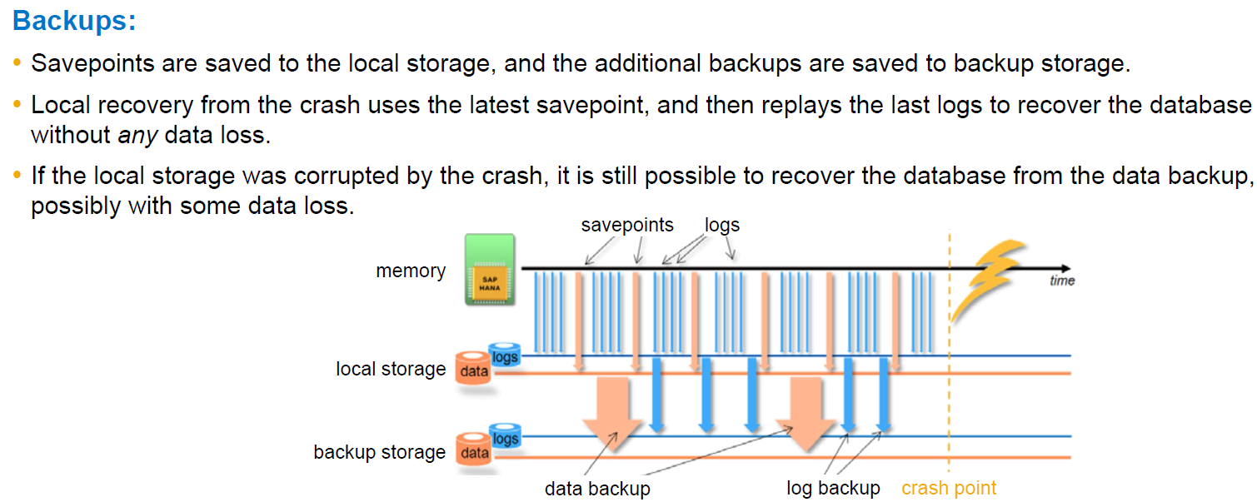
Backups and local persistence

Slide 8
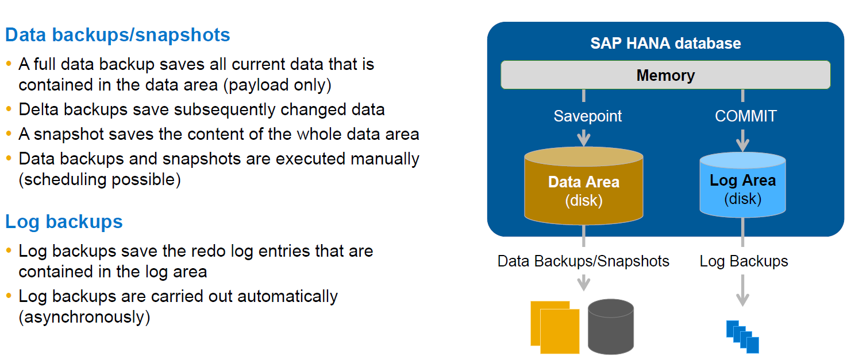
Memory -> disk -> backup

Slide 9
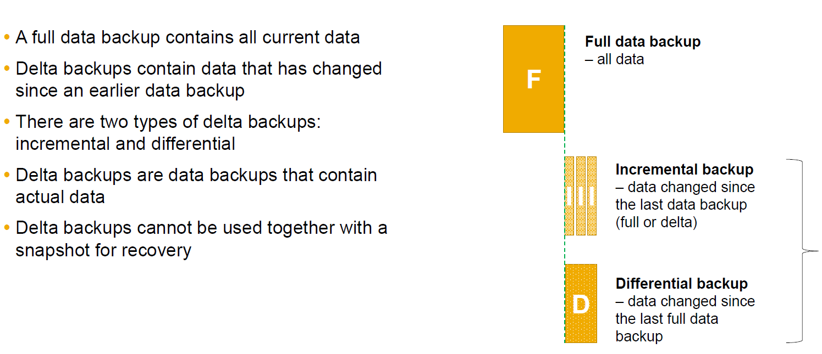
Data backups – Full and delta

Slide 10
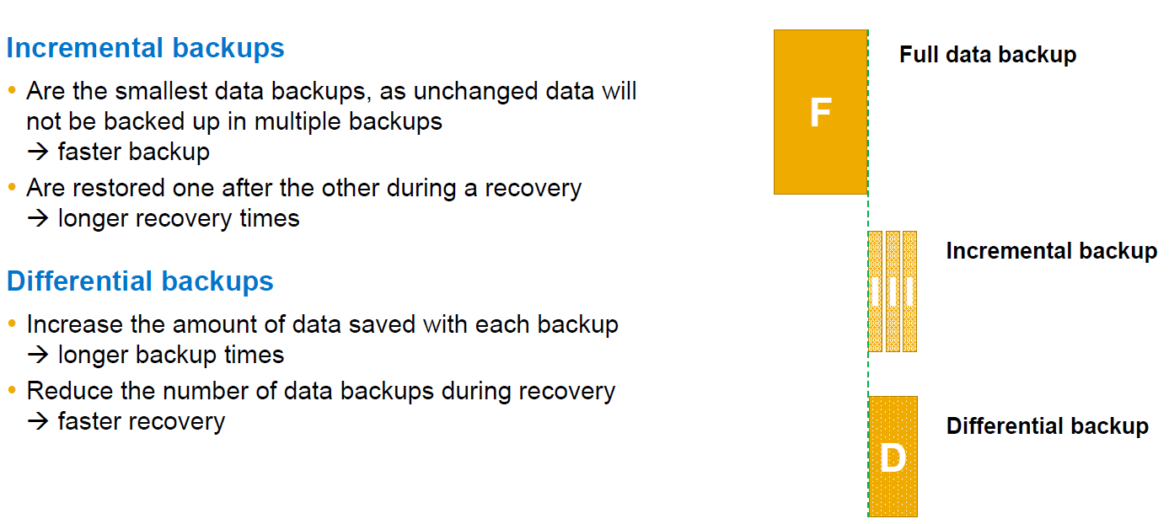
Delta backups – When to use what

Slide 11
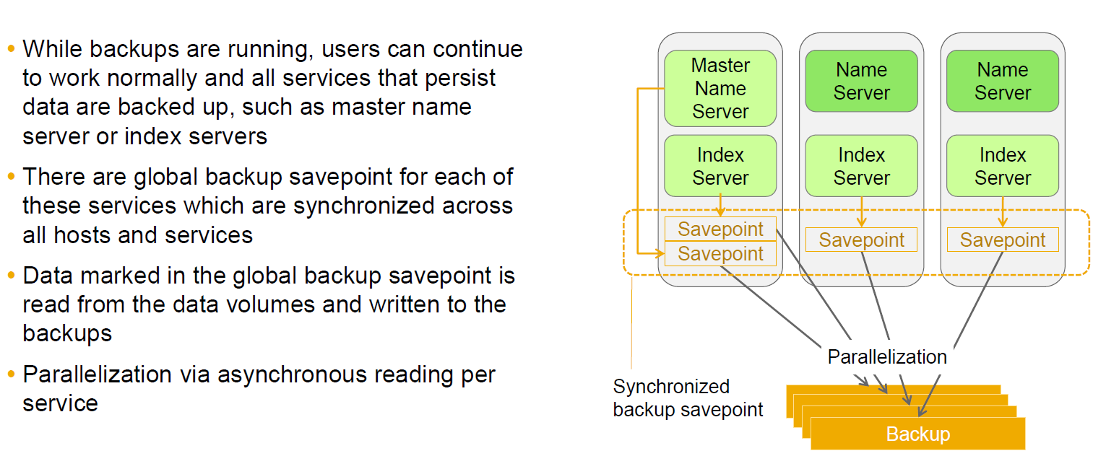
What happens during a data backup?

Slide 12
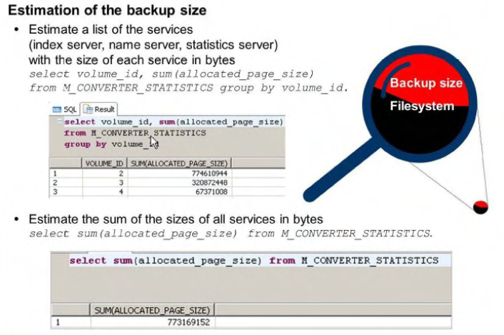
Estimation of the Size of a Backup
To estimate the size of the next complete data backup. you can use either of the following commands:
• select sum(allocated_page_size) from M_CONVERTER_STA TISTICS
The result is a single value that gives the sum of the sizes of all services in bytes. The size may differ between
SELECT statement and DATA BACKUP execution. For this reason. it is advisable to include
a reserve of free space.
• select volume_id. sum(allocated_page_size) from M_CONVERTER_STATISTICS Group by volume_id
This displays a list of the volumes (index server. name server. statistics server).
with the size of each volume in bytes.

Slide 13
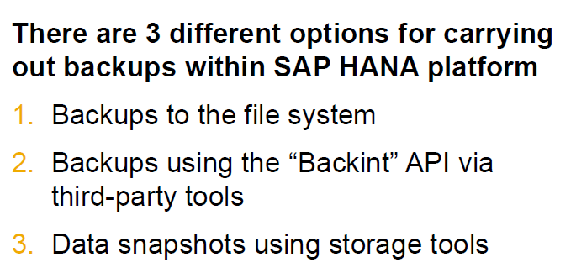
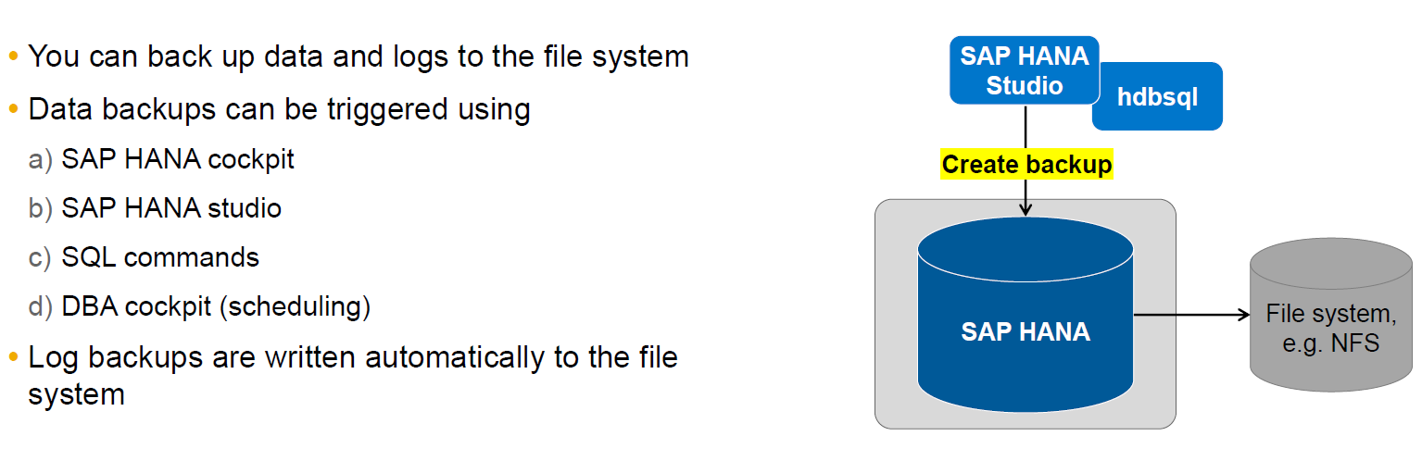
Options for backups
File System

Slide 14
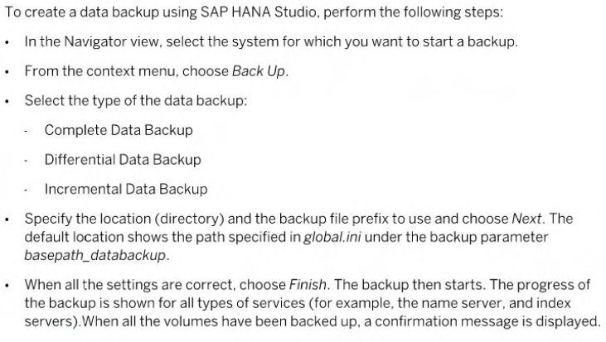
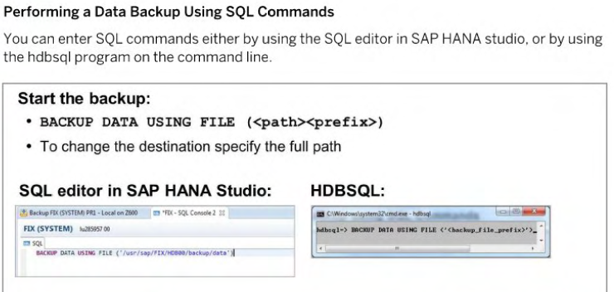
Performing a Data Backup

Slide 15
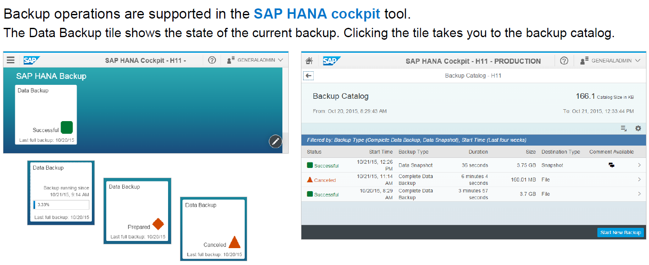
Backup operations in SAP HANA cockpit

Slide 16
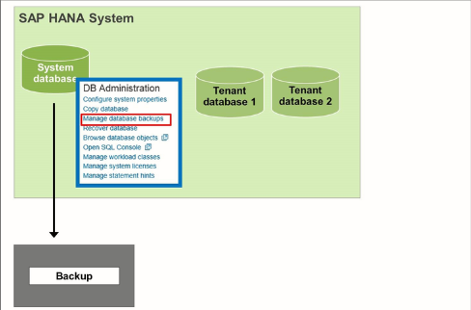
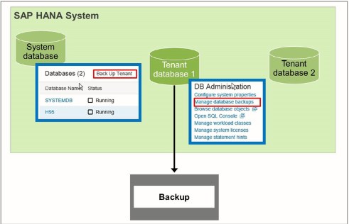
Performing Backups Using SAP HANA Cockpit
Backup of a Multitenant Database Container System
Using SAP HANA cockpit, you can create data backups and delta backups (differential backups and incremental backups). You need to create a backup for the system database and all tenant databases. Data backups of the system database are needed on a regularly basis. The system database contains information about the system as a whole and all tenant databases. It is used for central system administration.

Slide 17
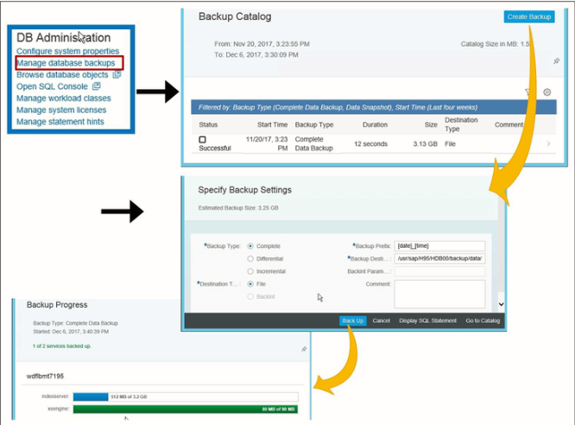
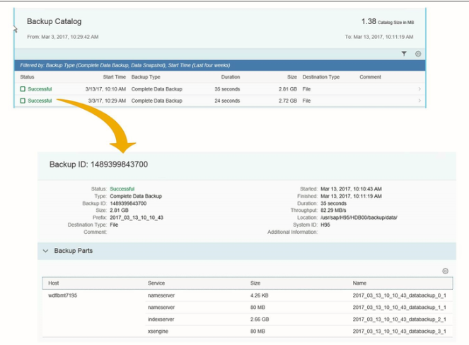
Backup

Slide 18
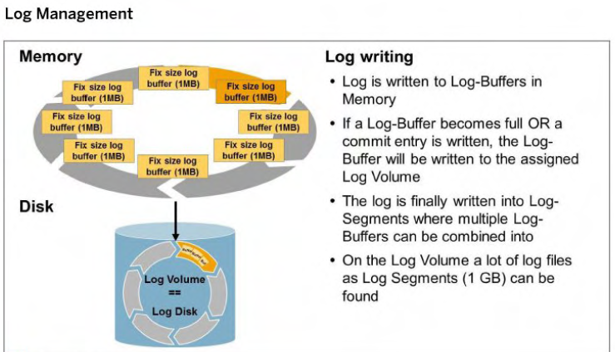
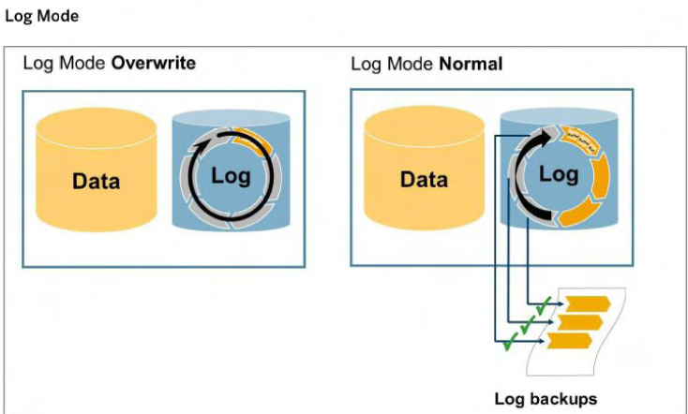
Log Area Backup
LOG MODE = OVERWRITE is not recommended for production systems.
With LOG_MODE = OVERWRITE, no point-in-time recovery is possible. For recovery, only data backups are used: the logs are not used. The Recover the database to a specific data backup recovery option is the only option that can be
selected.
A log segment is backed up in the following situations:
• The log segment is full.
• The log segment is closed after exceeding the configured time threshold.
• The database is started.

Slide 19
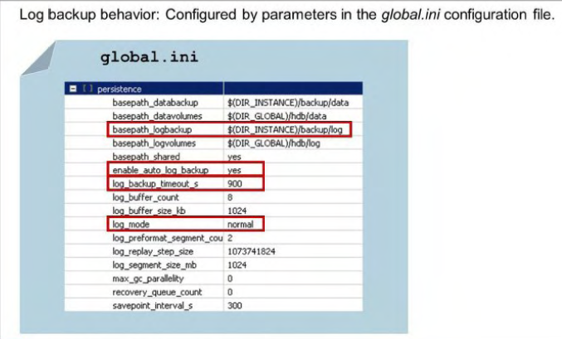
Configuring the Log Backup
Log Backup Timeout Parameter
The LOG_ BACKUP_ TIMEOUT_S parameter forces log backups at a fixed time interval. specified
in seconds. Log backups triggered by LOG_ BACKUT_TIMEOUT_Sa re performed in addition to
the log backups that are performed when a log segment becomes full.
We recommended that you specify a time interval, for example, 900s.
A time interval of O means that log backups are only made when a log segment is full and
when services are restarted.
Specifying an appropriate time interval for log backups enables you to recover an SAP HANA
database with minimum data loss. For example. if you need to recover the database in a
situation where the log area is unusable. and only the data and log backups are available.
The LOG _BACKUP_ TIMEOUT_ S parameter only takes effect if ENABLE AUTO LOG BACKUP is set.
For LOG_MODE = NORMAL, these parameters must have the following values:
• ENABLE AUTO LOG BACKUP - YES
• LOG BACKUP- TIMEOUTS> 0

Slide 20
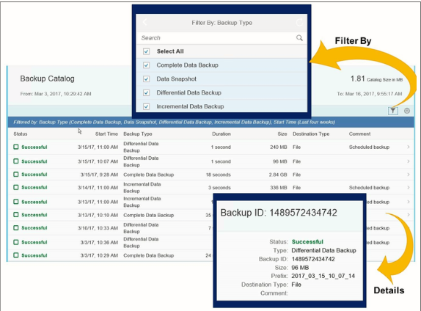
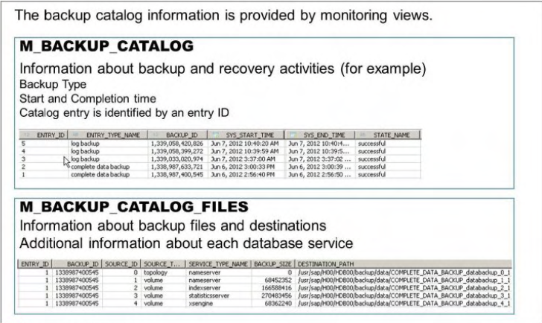
Backup Catalog
The backup catalog provides information about execution of backups and history.
It enables the system to do the following:
• Determine whether a recovery is possible
• Choose which data and log backup is used to recover database
• Determine which backup files are no longer needed

Slide 21
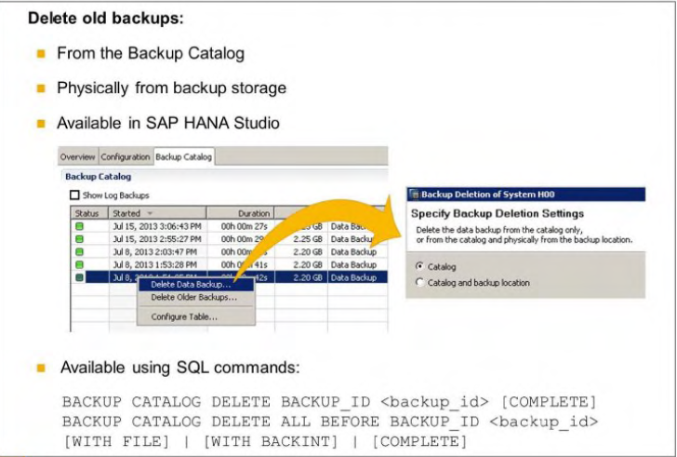
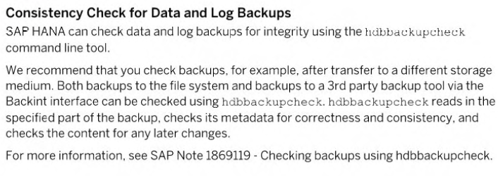

Slide 22
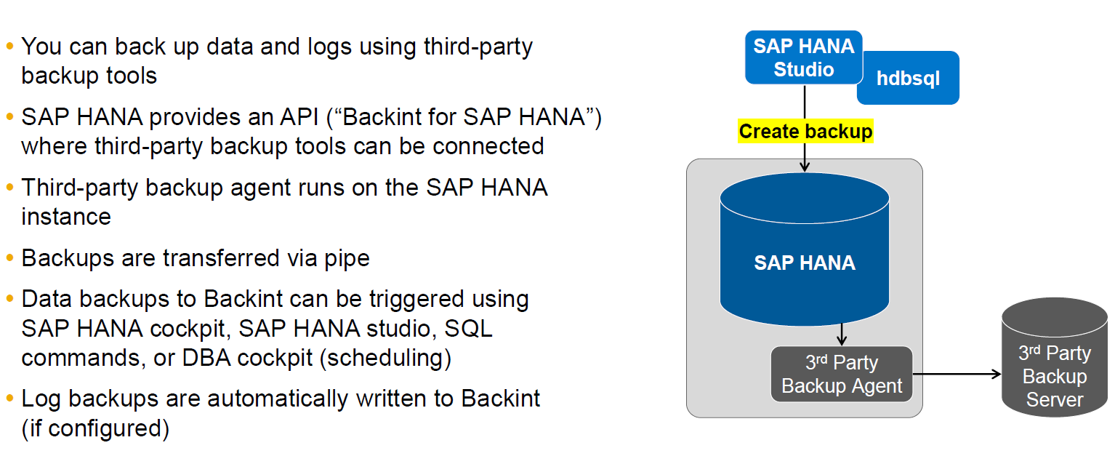
Backint API (via third-party backup tools)

Slide 23
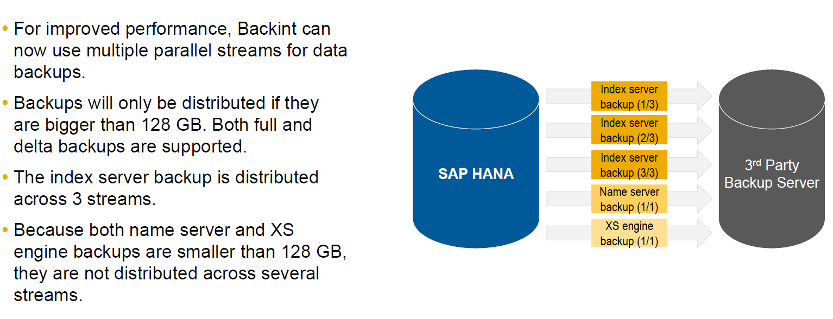
Backint – parallel streaming

Slide 24
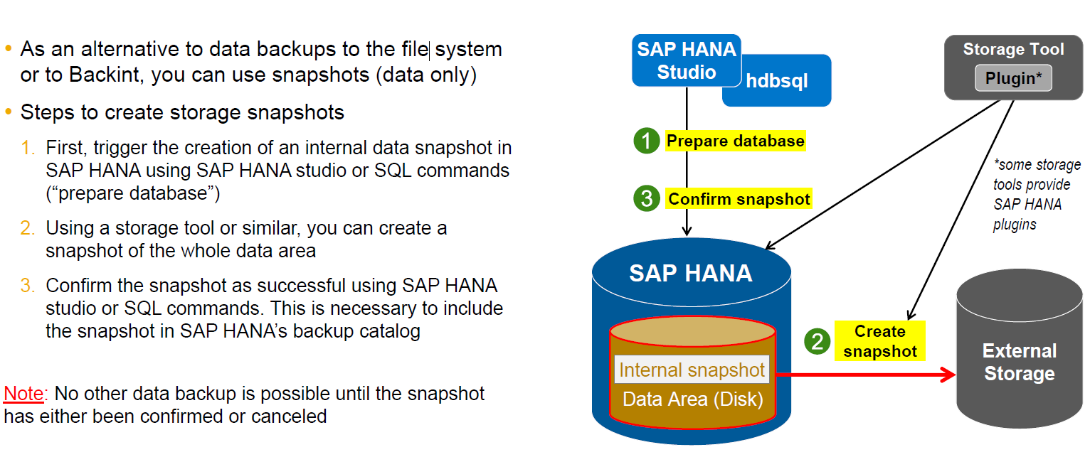
Storage snapshots

Slide 25
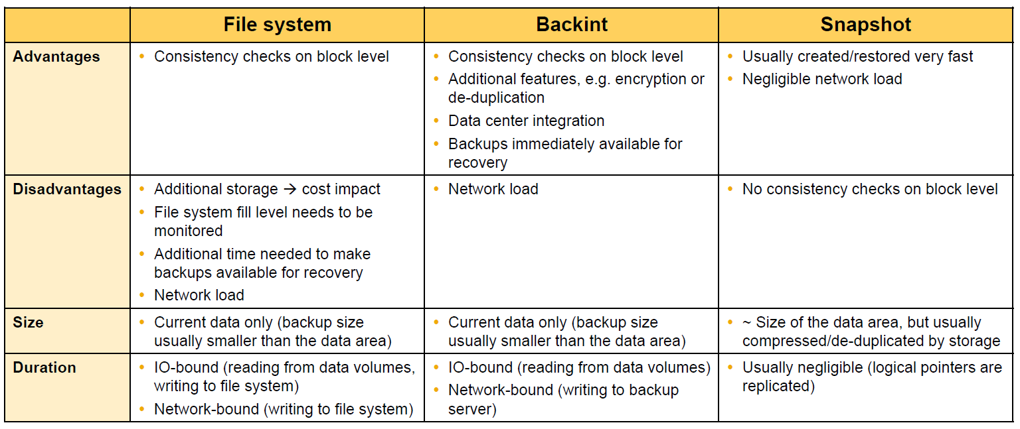
Backups: Comparison

Slide 26
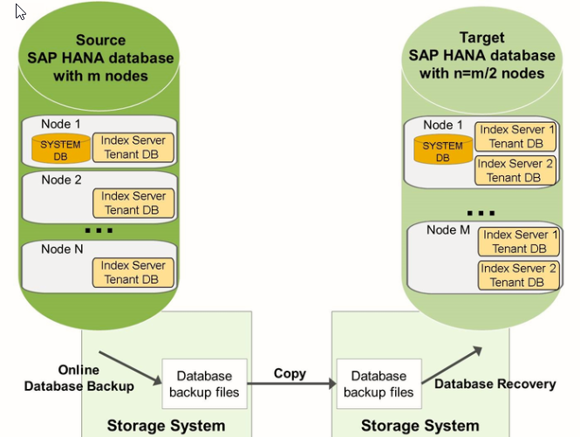
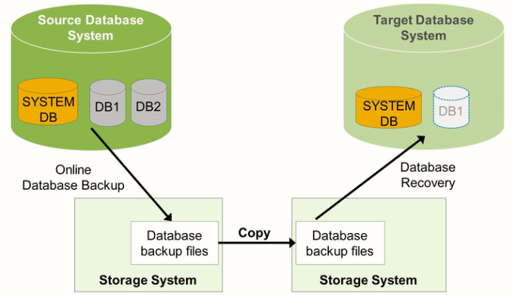
Copy a Database

Slide 27
Points to Note: Release Compatibility of SAP HANA Backups
In some situations, backups from earlier SAP HANA releases can be used for a recovery.
SAP HANA backups created with release 1.0 SPS10 or newer can be used to recover to SAP HANA 2.0.
This is true for both SAP HANA single-container systems and tenant databases.
A backup of an SAP HANA single-container system can only be recovered to a tenant database.
A backup of an SAP HANA single-container system cannot be recovered to a system database.

